Slide 1

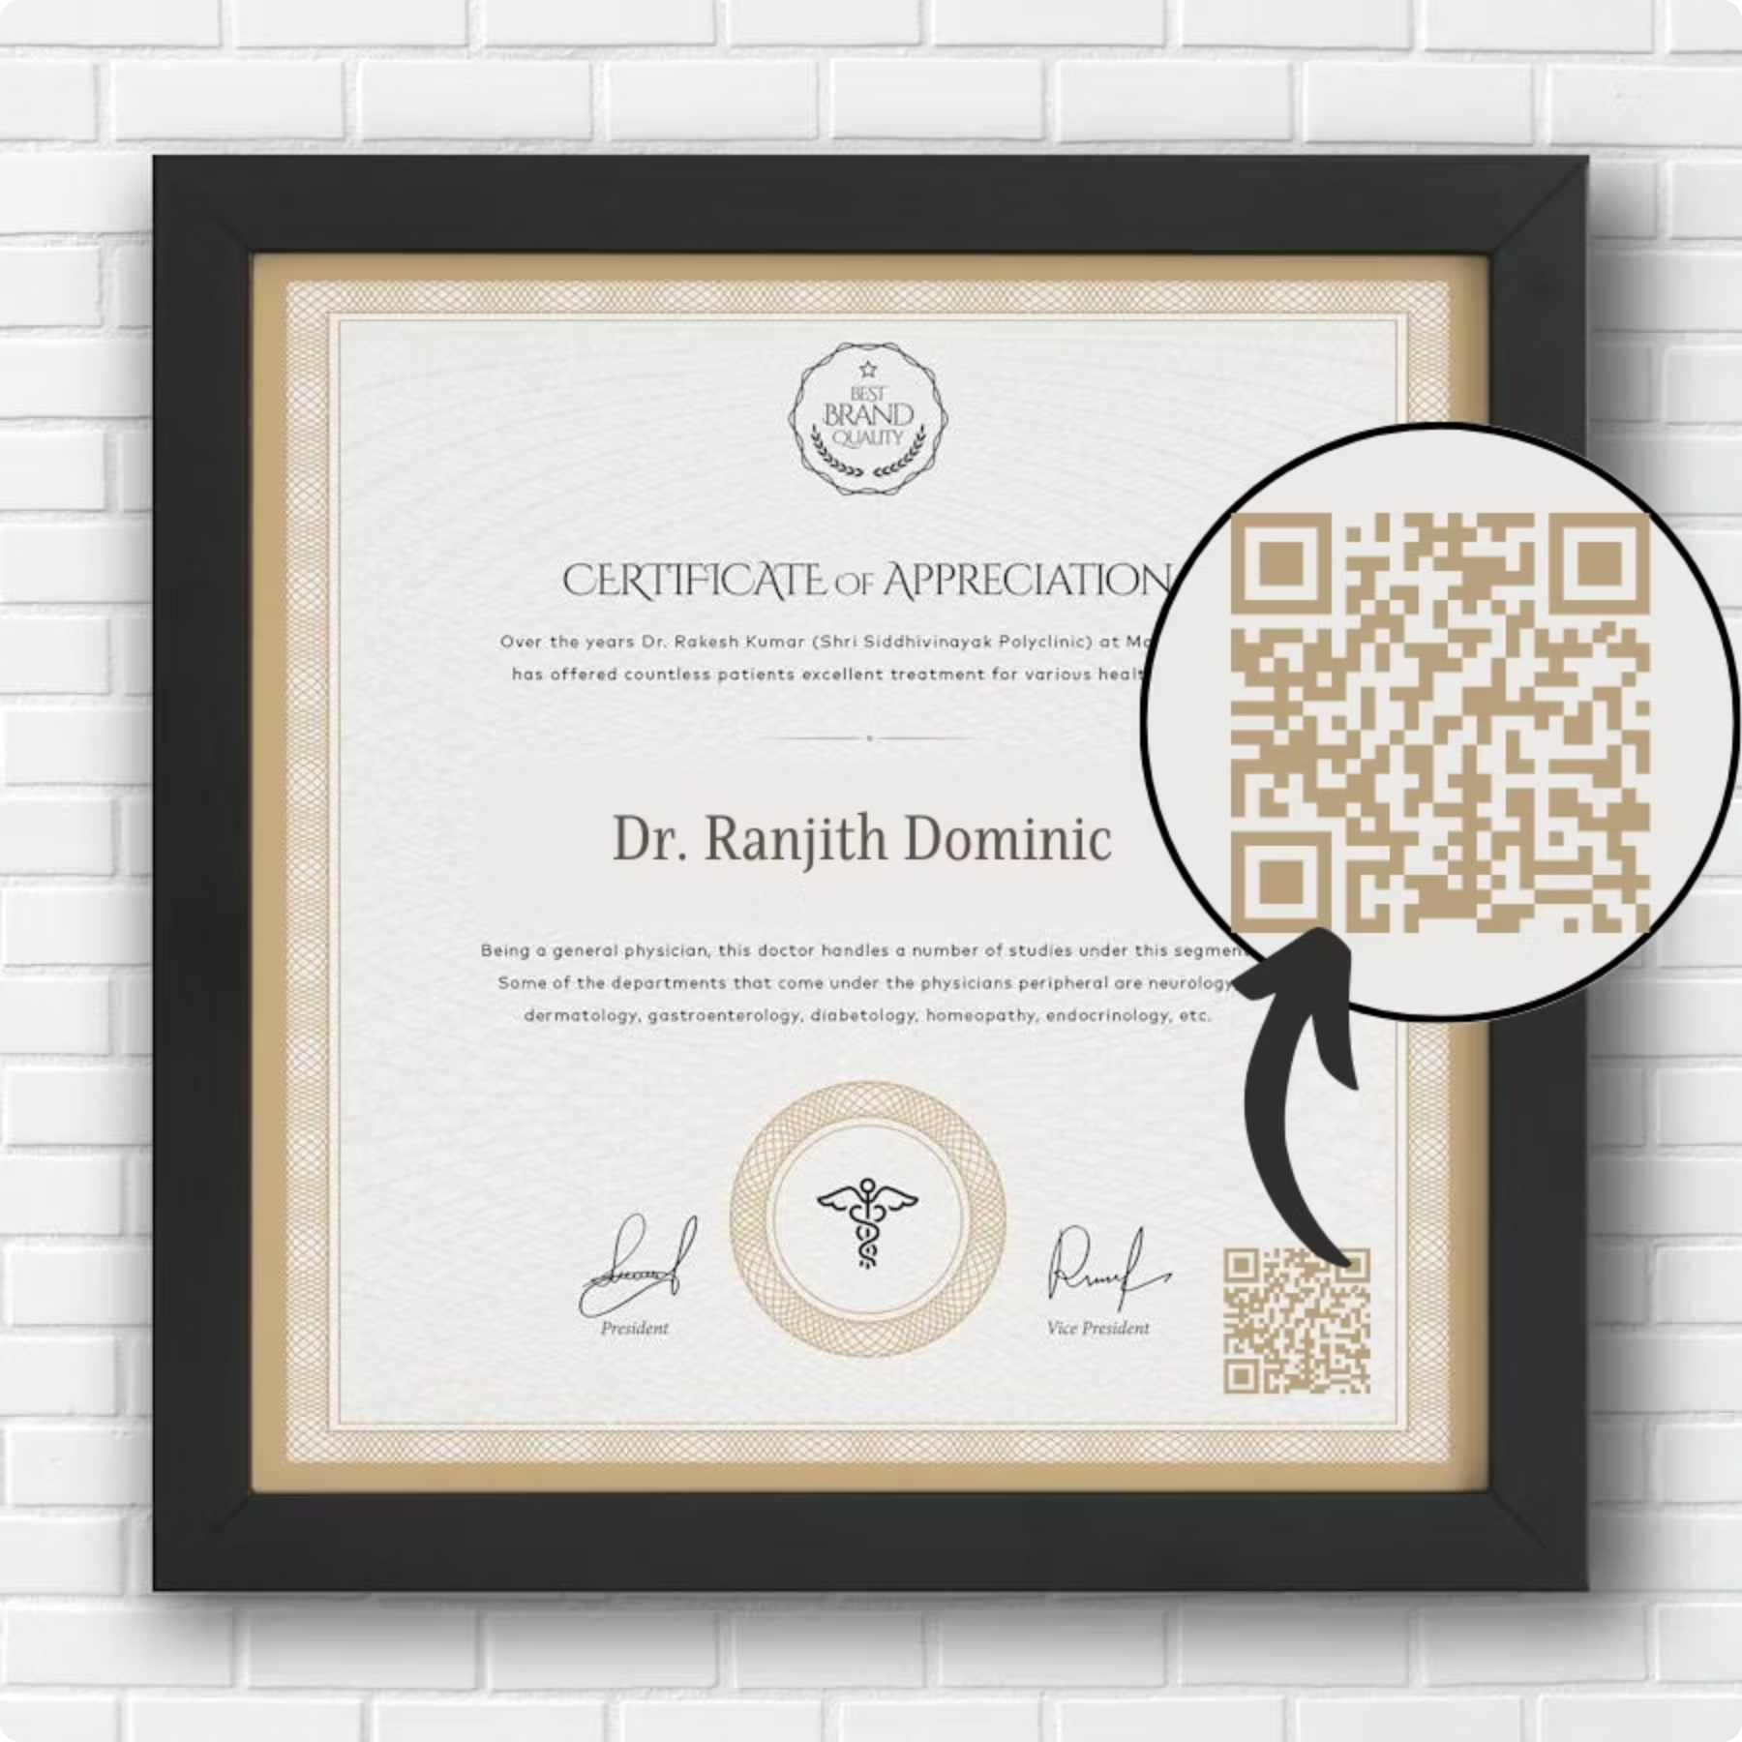
CoCred: Trusted Certificates, One Scan Away
A student-activity certification platform that revolutionizes how achievements are verified and shared.

Slide 2



The Problem
Paperwork Chaos
Slow Verification
Fake Certificates
Students struggle with physical certificates that get lost or damaged.
Online verification processes are time-consuming.
Employers face challenges identifying fraudulent credentials.

Slide 3




Our Solution
A streamlined certification process that ensures authenticity and accessibility.
Student Submits
Authority Validates
Activity details uploaded through simple interface
Institutional verification of submission
QR-Secured Certificate
Recruiter Verifies
Tamper-proof document generation
Instant authentication via scan

Slide 4
Key Features
Easy Online Submission
APAAR KYC Login
Intuitive interface for students to upload activity details and supporting documents.
Secure authentication using government-verified identity system.
QR-Sealed PDFs
Shareable Portfolio Link
Certificates with embedded verification codes that prevent tampering.
Digital showcase of all verified achievements in one accessible location.

Slide 5

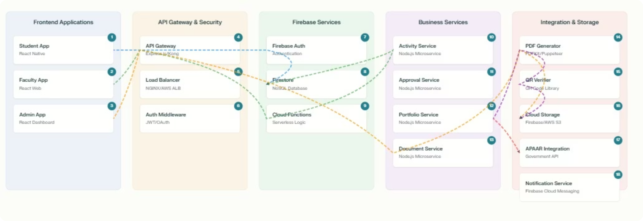



Technical Architecture
React Frontend
Firebase Services
Cloud Storage
Responsive UI for all user types
Auth, Firestore, Cloud Functions
Secure document management

Slide 6
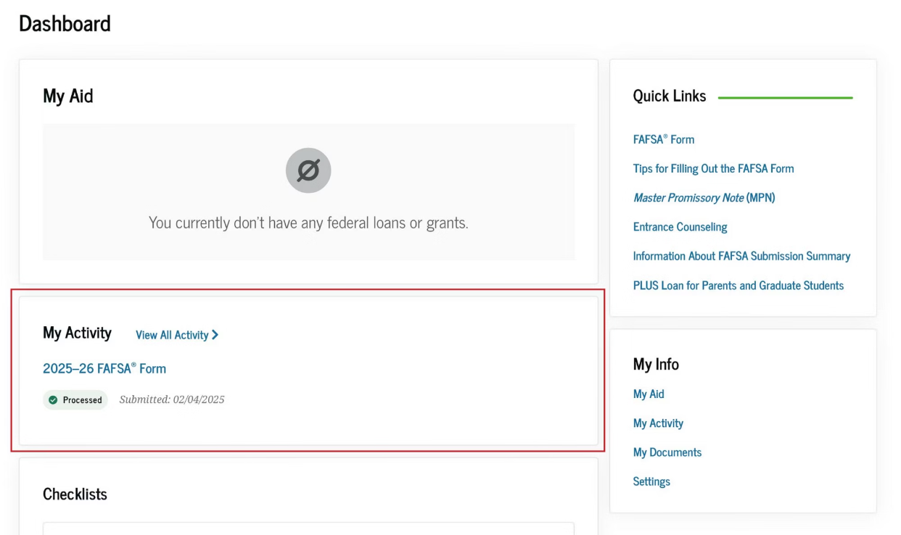
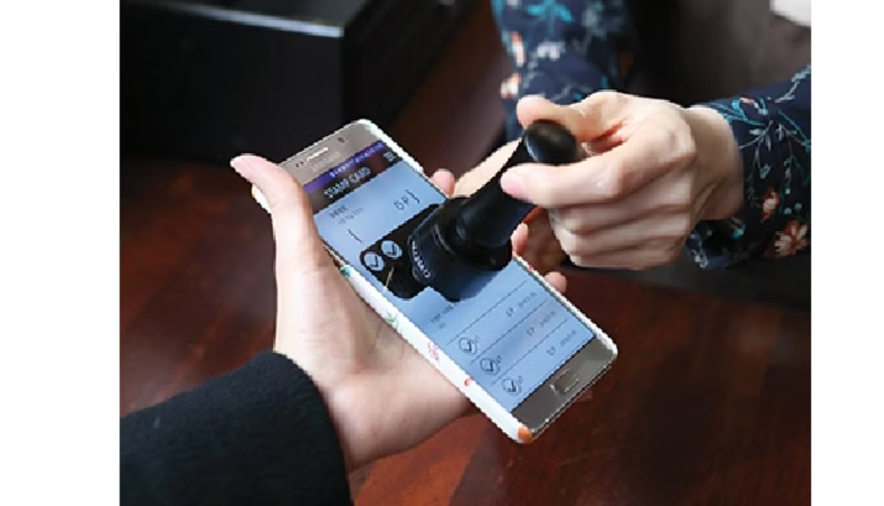
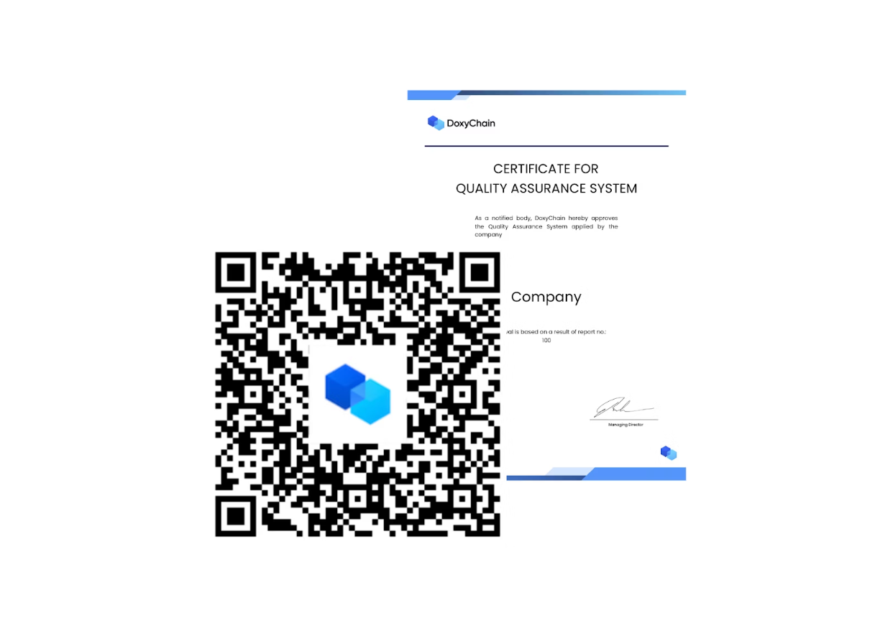
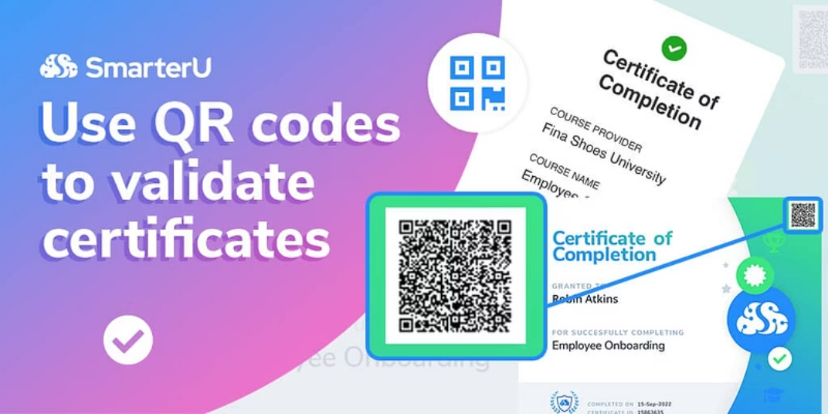
Demo Flow
1. Submit Activity
2. Validate
Students upload details and evidence
Authorities review and approve
4. Verify
Instant authentication via web portal
3. Generate Certificate
System creates secure PDF

Slide 7
Impact & Benefits
72 hrs
For Students
For Authorities
Secure, shareable portfolio of verified achievements
Streamlined verification process with reduced administrative burden
Spent on verification
Can help in reduction of verification process time
For Employers
90%
Instant, reliable verification of candidate credentials
Fraud Certificates
Can help in decrease of certificate falsification

Slide 8



Future Scope
Blockchain Integration
API Integrations
AI Analytics
Immutable records for permanent verification without central authority
Connect with educational platforms, job portals, and verification services
Skill insights and personalized development recommendations

Slide 9
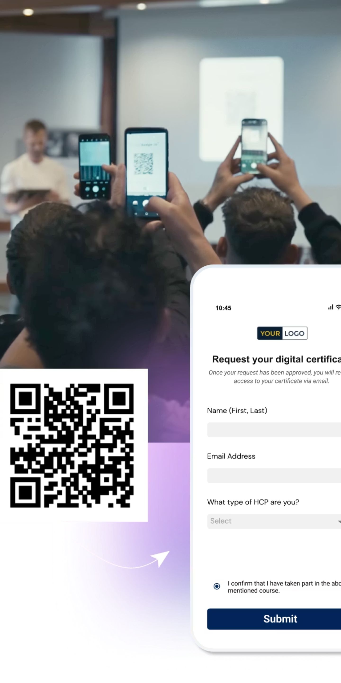
CoCred: Transforming Credential Verification
Trusted certificates, one scan away.
Ready to revolutionize how achievements are verified and shared.
Questions?

